Slide 1
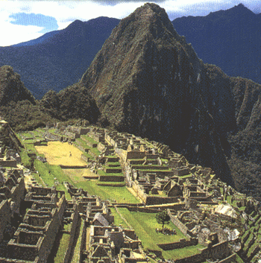
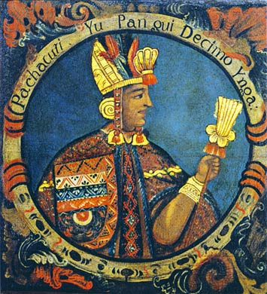
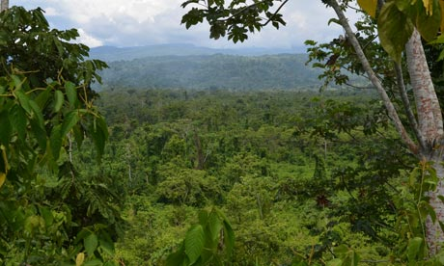
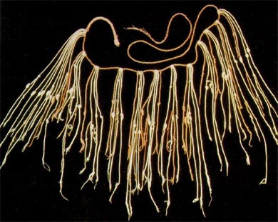
Incas

Slide 2
Directions
You have been split up into groups. Your task is to learn about your specific Meso-American civilization. To help you, guiding questions and links have been provided. Once complete, you will be in charge of teaching your classmates the information you have learned.
Steps:
Read information on slides and guiding questions.
Discuss readings and questions with group.
On chart paper, you and your group will take notes on major ideas from your readings and your questions in your own words to help teach class

Slide 3
Geography
Where did the Incas live?
How did geography both limit and help the Incas? Be sure to state any specific geographic boundaries!
Do geographic boundaries limit or help countries today? Use examples!
http://incas.mrdonn.org/geography.html

Slide 4
Technology and Innovations
Describe two innovations made by the Incas?
How were the Incas able to overcome geographic boundaries in order to communicate?
3. Farming was difficult where the Incas lived. Describe the technique they used to solve this problem.
http://blog.wsd.net/mmlarsen/files/2008/04/inca-inventions.pdf
http://incas.mrdonn.org/roads.html
https://www.youtube.com/watch?v=TZ_79i-KUvE
http://www.socialstudiesforkids.com/articles/geography/terracefarming.htm

Slide 5
Government
1. What form of government did the Inca have? Who was in control?
2. How did the leader maintain control of the empire? How was money earned for the government?
3. Why was there so little crime in the empire?
4. In your own words, who was Pachacuti and why was he important?
http://www.ducksters.com/history/inca/government.php
http://www.britannica.com/biography/Pachacuti-Inca-Yupanqui

Slide 6
Calendar
1. What was the main reason why the Incas had a calendar (hint- it wasn’t to tell the day of the week!)?
2. What was the purpose of the lunar calendar?
3.How advanced or limited do you believe the Incan calendar is?
http://www.sjusd.org/leland/teachers/sgillis/geog/la/inca_astronomy_calendar.pdf

